Slide 1
Rekindle the flame Revelation 2:1-7
“To the of the church in Ephesus write: These are the words of him who holds the seven stars in his right hand and walks among the seven golden lampstands. I know your deeds, your hard work and your perseverance. I know that you cannot tolerate wicked people, that you have tested those who claim to be apostles but are not, and have found them false. You have persevered and have endured hardships for my name, and have not grown weary.

Slide 2
Rekindle the flame Revelation 2:1-7
Yet I hold this against you: You have forsaken the love you had at first. Consider how far you have fallen! Repent and do the things you did at first. If you do not repent, I will come to you and remove your lampstand from its place.But you have this in your favor: You hate the practices of the Nicolaitans, which I also hate. Whoever has ears, let them hear what the Spirit says to the churches. To the one who is victorious, I will give the right to eat from the tree of life, which is in the paradise of God.”

Slide 3
Revelation 2:1-7
The common structure of the letters
1.
The instruction to write …
3.
The prophetic message: “I know…”
4.
The final exhortation: “he who has an ear to hear, let him hear…”
2.
“Thus says” = ”these are the words of him who…”
To the angel of……………….write ”

Slide 4
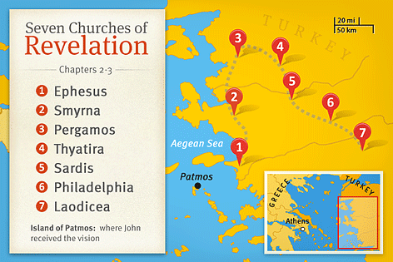
Revelation 2:1-7
The common structure of the letters
The Instructions
“to the angel of the church…write”

Slide 5
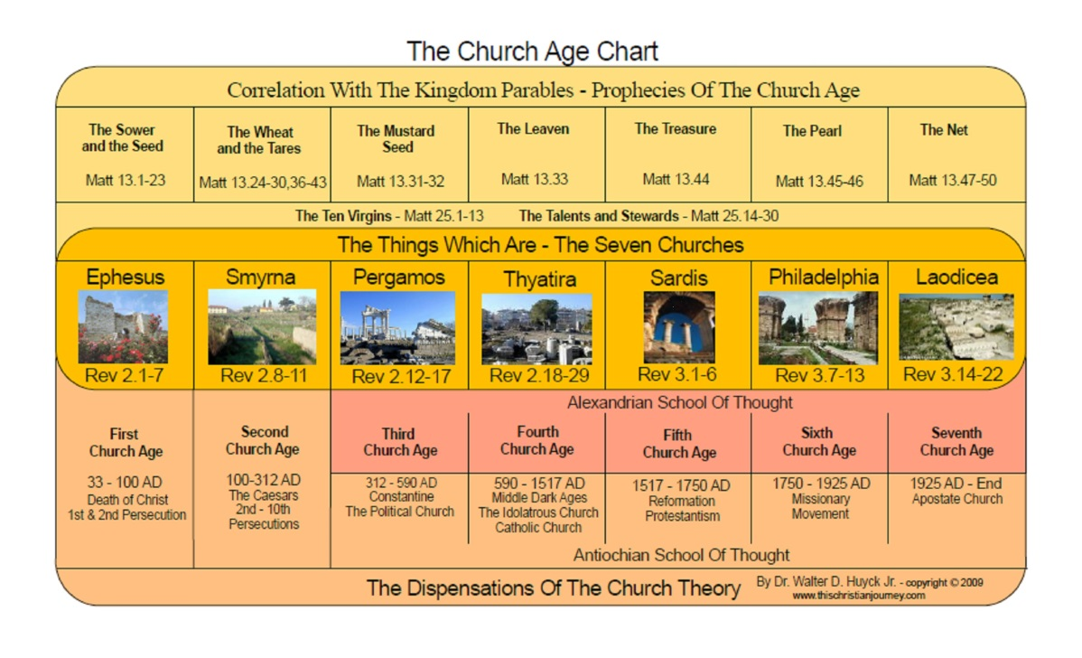
Revelation 2:1-7
The common structure of the letters
The Instructions
“to the angel of the church…write”

Slide 6
Revelation 2:1-7
The common structure of the letters
The Instructions
“to the angel of the church…write”
“Blessed is the one who reads aloud the words…”
The churches on same road in order of delivery
Local details in the message to each church
“He who has an ear to hear let him hear what the Spirit says to the churches”2:7,11,17,29; 3:6,13,22

Slide 7
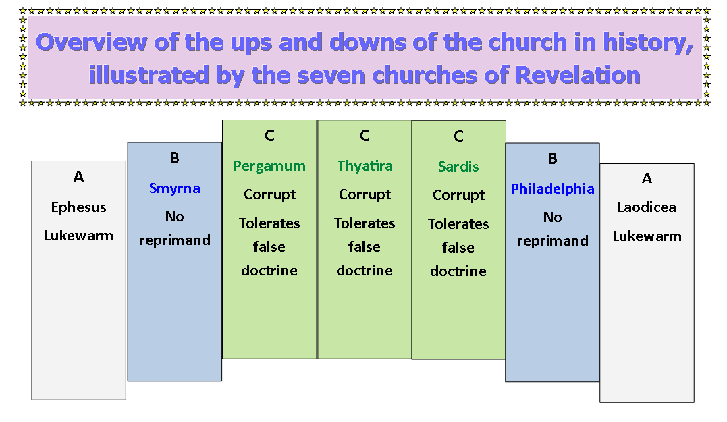
Revelation 2:1-7
The common structure of the letters
The Instructions
“to the angel of the church…write”

Slide 8
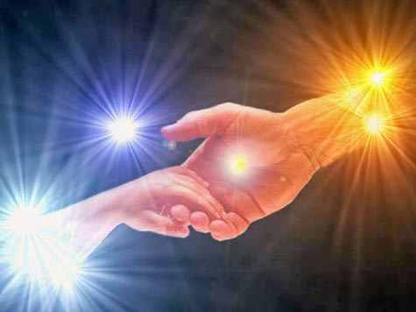
Revelation 2:1-7
The common structure of the letters
The Instructions
“to the angel of the church…write”
Identity of the angels

Slide 9
Revelation 2:1-7
The common structure of the letters
The Instructions
These are the words of…

Slide 10
Revelation 2:1-7
The common structure of the letters
The Instructions
These are the words of…
The prophetic message - “I know!”

Slide 11
Revelation 2:1-7
The common structure of the letters
The Instructions
These are the words of…
The prophetic message
A two - part exhortation

Slide 12
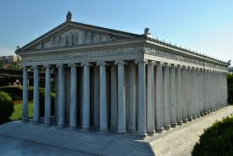
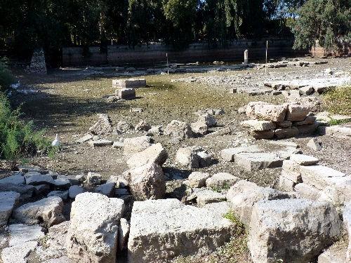
Rekindle the flame
The message to the Ephesian church
The context (Acts 19)
Artist’s impression of Temple of Artemis
The site of the Temple today

Slide 13
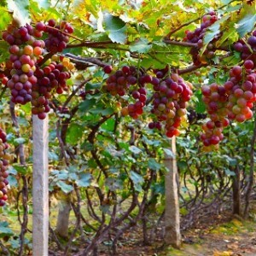
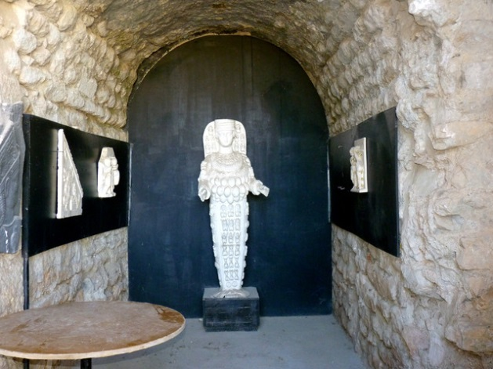
Rekindle the flame
The message to the Ephesian church
The context – (Acts 19)
The impact
All the Jews and Greeks in the province of Asia heard the word (Acts 19:10)
Great is Diana of the Ephesians (Acts 19:28)

Slide 14
Rekindle the flame
The message to the Ephesian church
The identity of the one who speaks:
“These are the words of him who hold the seven stars in his right hand and walks among the seven golden lampstands.”
He controls the angels

Slide 15
Rekindle the flame
The message to the Ephesian church
The identity of the one who speaks:
“These are the words of him who hold the seven stars in his right hand and walks among the seven golden lampstands.”
He controls the angels
He walks among the churches – like an OFSTED inspector!

Slide 16
Rekindle the flame
The message to the Ephesian church
The identity of the one who speaks:
The prophetic message – “I know”

Slide 17
Rekindle the flame
The message to the Ephesian church
The identity of the one who speaks:
The prophetic message – “I know”
Commendations
I know your good deeds

Slide 18
Rekindle the flame
The message to the Ephesian church
The identity of the one who speaks:
The prophetic message – “I know”
Commendations
I know your good deeds
I know your hard work

Slide 19
Rekindle the flame
The message to the Ephesian church
The identity of the one who speaks:
The prophetic message – “I know”
Commendations
I know your good deeds
I know your hard work
I know your perseverance

Slide 20
Rekindle the flame
The message to the Ephesian church
The identity of the one who speaks:
The prophetic message – “I know”
Commendations
I know your good deeds
I know your hard work
I know your perseverance
I know your discernment/ vigilance

Slide 21
Rekindle the flame
The message to the Ephesian church
The identity of the one who speaks:
The prophetic message – “I know”
Commendations
Reproach - “You have forsaken your first love.”

Slide 22
Rekindle the flame
The message to the Ephesian church
The identity of the one who speaks:
The prophetic message – “I know”
Commendations
Reproach - “You have forsaken your first love.”
“I remember the devotion of your youth, how as a bride you followed me through the desert” (Jer. 2:2)

Slide 23
Rekindle the flame
The message to the Ephesian church
The identity of the one who speaks:
The prophetic message – “I know”
Commendations
Reproach - “You have forsaken your first love.”
“I am not writing to you a new command but one we had from the beginning. I ask that we love another. And this is love: that we walk in obedience to his commands.” 2 John 5-6

Slide 24
Rekindle the flame
The message to the Ephesian church
The identity of the one who speaks:
The prophetic message – “I know”
Commendations
Reproach
Exhortations:

Slide 25
Rekindle the flame
The message to the Ephesian church
The identity of the one who speaks:
The prophetic message – “I know”
Commendations
Reproach
Exhortations: “Remember!”

Slide 26
Rekindle the flame
The message to the Ephesian church
The identity of the one who speaks:
The prophetic message – “I know”
Commendations
Reproach
Exhortations: “ Remember!”
“Remember how the Lord your God led you all the way in the desert these forty years, to humble you and test you in order in order to test you in order to know what was in your heart…Be careful that you do not forget the Lord your God…otherwise, when you…are satisfied…then your heart will become proud and you will forget the Lord your God who brought you out of slavery” Deut. 8:2,11,14)

Slide 27
Rekindle the flame
The message to the Ephesian church
The identity of the one who speaks:
The prophetic message – “I know”
Commendations
Reproach
Exhortations: “ Remember!”
“ Repent!”

Slide 28
Rekindle the flame
The message to the Ephesian church
The identity of the one who speaks:
The prophetic message – “I know”
Commendations
Reproach
Exhortations
Warning
“If you do not repent, I will come to you and remove your lampstand from its place” (v.5)

Slide 29
Rekindle the flame
The message to the Ephesian church
The identity of the one who speaks:
The prophetic message – “I know”
Exhortation and promise
“He who has an ear, let him hear what the Spirit says to the churches. To him who overcomes, I will give the right to eat from the tree of life which is in the paradise of God” (v.7)

Slide 30
Rekindle the flame
The message to the Ephesian church
The identity of the one who speaks:
The prophetic message – “I know”
Exhortation and promise
General exhortations
Have we forsaken our first love?

Slide 31
Rekindle the flame
The message to the Ephesian church
The identity of the one who speaks:
The prophetic message – “I know”
Exhortation and promise
General exhortations
Have we forsaken our first love?
Danger of getting side-tracked!

Slide 32
Rekindle the flame
The message to the Ephesian church
The identity of the one who speaks:
The prophetic message – “I know”
Exhortation and promise
General exhortations
Have we forsaken our first love?
Danger of getting side-tracked!
Danger of false dreams, ambitions

Slide 33
Rekindle the flame
The message to the Ephesian church
The identity of the one who speaks:
The prophetic message – “I know”
Exhortation and promise
General exhortations
Have we forsaken our first love?
How do we preserve the passion?

Slide 34
Rekindle the flame
The message to the Ephesian church
The identity of the one who speaks:
The prophetic message – “I know”
Exhortation and promise
General exhortations
Have we forsaken our first love?
How do we preserve the passion?
“Love the Lord your God with all your passion, prayer, intelligence and energy” Mark 12:30 (The Message)

Slide 35
Rekindle the flame
The message to the Ephesian church
The identity of the one who speaks:
The prophetic message – “I know”
Exhortation and promise
General exhortations
Have we forsaken our first love?
How do we preserve the passion?
“Never be lacking in zeal, but keeping your spiritual fervour, serving the Lord.” Romans 12:11

Slide 36
Rekindle the flame
The message to the Ephesian church
The identity of the one who speaks:
The prophetic message – “I know”
Exhortation and promise
General exhortations
Have we forsaken our first love?
How do we preserve the passion?
What conspires to kill the passion?

Slide 37
Rekindle the flame
The message to the Ephesian church
The identity of the one who speaks:
The prophetic message – “I know”
Exhortation and promise
General exhortations
Have we forsaken our first love?
How do we preserve the passion?
What conspires to kill the passion?
An unbalanced schedule – see Psalm 127:2

Slide 38
Rekindle the flame
The message to the Ephesian church
The identity of the one who speaks:
The prophetic message – “I know”
Exhortation and promise
General exhortations
Have we forsaken our first love?
How do we preserve the passion?
What conspires to kill the passion?
An unbalanced schedule – see Psalm 127:2
Unused talents – 1 Peter 4:10

Slide 39
Rekindle the flame
The message to the Ephesian church
The identity of the one who speaks:
The prophetic message – “I know”
Exhortation and promise
General exhortations
Have we forsaken our first love?
How do we preserve the passion?
What conspires to kill the passion?
An unbalanced schedule – see Psalm 127:2
Unused talents – 1 Peter 4:10
Unconfessed sin – Psalm 38

Slide 40
Rekindle the flame
The message to the Ephesian church
The identity of the one who speaks:
The prophetic message – “I know”
Exhortation and promise
General exhortations
Have we forsaken our first love?
How do we preserve the passion?
What conspires to kill the passion?
An unbalanced schedule – see Psalm 127:2
Unused talents – 1 Peter 4:10
Unconfessed sin – Psalm 38
Unresolved conflict – Job 5:2

Slide 41
Rekindle the flame
The message to the Ephesian church
The identity of the one who speaks:
The prophetic message – “I know”
Exhortation and promise
General exhortations
Have we forsaken our first love?
How do we preserve the passion?
What conspires to kill the passion?
An unbalanced schedule – see Psalm 127:2
Unused talents – 1 Peter 4:10
Unconfessed sin – Psalm 38
Unresolved conflict – Job 5:2
Unsupported lifestyle – Eccl. 4:9-10

Slide 42
Rekindle the flame
The message to the Ephesian church
The identity of the one who speaks:
The prophetic message – “I know”
Exhortation and promise
General exhortations
Have we forsaken our first love?
How do we preserve the passion?
What conspires to kill the passion?
An unbalanced schedule – see Psalm 127:2
Unused talents – 1 Peter 4:10
Unconfessed sin – Psalm 38
Unresolved conflict – Job 5:2
Unsupported lifestyle – Eccl. 4:9-10
Unclear purpose - Phil. 1:21

Slide 43
Rekindle the flame
The message to the Ephesian church
The identity of the one who speaks:
The prophetic message – “I know”
Exhortation and promise
General exhortations
Have we forsaken our first love?
How do we preserve the passion?
What conspires to kill the passion?
An unbalanced schedule – see Psalm 127:2
Unused talents – 1 Peter 4:10
Unconfessed sin – Psalm 38
Unresolved conflict – Job 5:2
Unsupported lifestyle – Eccl. 4:9-10
Unclear purpose - Phil. 1:21
Undernourished spirit –Exodus 34:14

